Slide 1
JAUNDICE IN PREGNANCY
DR. MAYSARA MOHAMMED
CABOG,FICMS

Slide 2
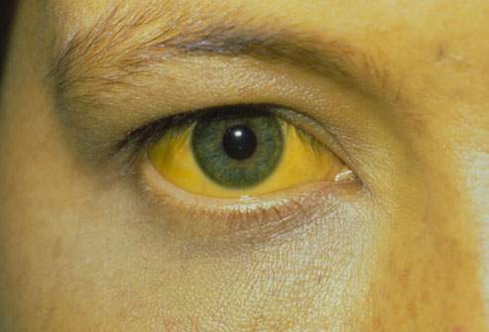
Yellow discoloration of skin, conjunctiva, sclera and mucosa associated with rise in serum bilirubin above 2mg/dl
( normal 0.2-1mg/dl)

Slide 3
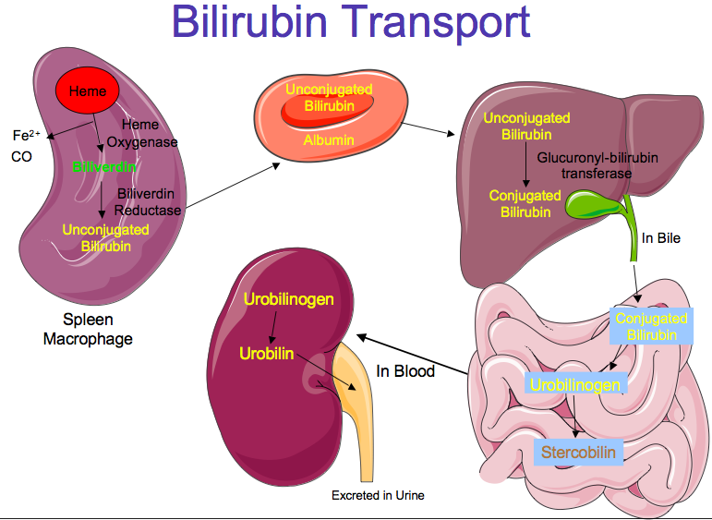

Slide 4
Physiological changes in liver during pregnancy
Liver is not palpable during pregnancy.
Sr. protein decrease by 20%.
ALP level increase.
S.bilirubin,porthrombin time& liver aminotransferase remain unchanged

Slide 5
Jaundice unrelated to pregnant state
HEPATIC CAUSES
Acute viral hepatitis
Drug induced hepatitis
Chronic hepatitis
-viral (HBV, HCV)
-Autoimmune hepatitis
Wilson’s disease
Cirrhosis of liver
PRE-HEPATIC CAUSES
Hemolytic anemia
POST-HEPATIC CAUSES
Common bile duct stone/ strictures

Slide 6
Causes of jaundice during pregnancy
Jaundice specific to pregnancy
Hyperemesis gravidarum
Intrahepatic cholestasis of pregnancy
Pre-eclampsia/ eclampsia
HELLP Syndrome
Acute fatty liver of pregnancy

Slide 7
Acute fatty liver of pregnancy
Acute hepatic failure in absence of viral hepatitis, IHC, etc.
Manifest usually in 3rd trimester,rarely after delivery
Rare condition,more common in primigravida obese,multiple pregnancy, male fetus and associated with pre-eclampsia in 50% of cases

Slide 8
Etiology:unkown
Associated with inherited mitochondrial defect in oxidation pathway of fatty acid.
↑estrogen in 3rd trimester leads to ↓ mitochondrial oxidation.

Slide 9
Clinical features and diagnosis
Clinical features: Anorexia, nausea, vomiting, headache, fatigue, altered mental status, polydypsia ,Jaundice 90%,
Right upper quadrant pain.
Hepatic encephalopathy seen in latter.
Clinical improvement occurs 1-4 weeks after delivery..

Slide 10
conjugated hyperbilirubinimia up to 5-15 mg/dl.
↑ALT but <1000iu/ml.
Coagulopathy
hypoglycemia. Hyperurecemia,
leukocytosis,
USG, CT, MRI demonstrate fatty infiltration.
liver biopsy is gold standered.
--microvesicular fatty infiltration

Slide 11
Prognosis
Maternal mortality:10-15%
Hepatic encephalopathy, DIC, Renal failure, PPH.
Fetal mortality: 15-20%
IUD , prematurity.

Slide 12
Management
Optimal management is prompt delivery prior to development of coagulopathy. Transfer to high dependency unit.
FFP, platelets, blood transfusion,vit K to correct coagulopathy.
iv glucose to maintain normoglycemia.
monitor LFT with PT.
In fulminant hepatic failure liver transplantation is only treatment.

Slide 13
Intrahepatic cholestasis of pregnancy
Typically manifest in 3rd trimester .
Puritus without rash usually involves the trunk and the extremities, including the palms and the soles of the feet,may lead to insomnia .
Disappears 24-48 hours postpartum (but biochemical and histological abnormalities take longer to resolve
Dark colour urine.
Jaundice seen in 10% cases usually mild ,develop 1-4 wks after pruritus.

Slide 14
Intrahepatic cholestasis of pregnancy
ETIOLOGY:
Hereditary hepatic ↑ sensitivity of pregnancy hormone → affects gallbladder function →slow or stop the bile flow →build up of bile acid in liver.
LAB STUDY
Increase Sr.bile acid and/or abnormal LFT.
AST &ALT mildly increase.
↑conjugated bilirubin 20% cases. But level between 2-5mg/dl

Slide 15
management
Antihistamines and topical emollients
Ursodeoxycholic acid(UDCA):10-20mg/kg/day, relieves purities by decreasing the concentration of bile acid.
---liver function test should be repeated weekly until
delivery and at 6weeks postpartum to ensure
return to normal baseline. .
Water soluble Vit-k: 10 mg daily

Slide 16
Prognosis
Fetal risk:
-- morbidity increase if bile acid more than 40micmol/l,
-preterm delivery
-intrapartum fetal distress. - meconium aspiration. –IUD so induction of labour after 37week is usually planned.
Maternal risk:
-↑caesarean section rate -PPH
- recurrence in next pregnancy.

Slide 17
HELLP syndrome
characterized by haemolysis, elevated liver enzyme ,low platelet.
Majority with HELLP syndrome have HTN and proteinuria, but it may absent in10-20% cases.
Clinical picture: nausea, vomiting, malaise, headache, upper abdominal pain, HTN,

Slide 18
DIAGNOSIS
Peripheral smear: features of hemolysis i.e schizocytes, Burr cells,↑reticulocytes, ↑LDH. ↑Uncojugated bilirubin
-- thrombocytopenia.
Elevated liver enzyme--↑ALT and AST.
CT or USG if subcapsular hematoma is suspected.

Slide 19
Management
Stabilizes maternal condition.
Control HTN.
Antiseizure prophylaxis with mgso4.
Correct coagulopathy. Assessment of fetal wellbeing.
Definitive therapy is delivery irrespective of gestation.
Mode of delivery: vaginal delivery preferred..

Slide 20
Hyper emesis gravidarum
Extreme of spectrum of morning sickness.
c/b intractable nausea, vomiting ,dehydration, metabolic alkalosis, electrolyte imbalance, weight loss.

Slide 21
Management
Hospitalization in severe case,
Restriction of oral fluid, and iv fluid given to correct dehydration.
Anti emetics and B1.
steroid use in severe case.

Slide 22
Acute viral hepatitis
The commonest cause of jaundice in pregnancy.
Caused by hepatiti A,B,C,D,E or herpes simplexVIRUS
Acute viral hepatitis in the first trimester--→higher rate of miscarriage .
Clinical picture is as in non pregnant except for hepatitis E which may lead to fulminant hepatic failure especially in primigravida in the third trimester and for herpes simplex(the outcome is improved by aciclovir

Slide 23
Hepatitis A:
It does not appear to alter the normal course of pregnancy, nor does pregnancy appear to influence the natural history of hepatitis A,vertical transmission is very rare.
Post exposure immunoglobin and vaccine may be given to seronagative.

Slide 24
Hepatitis B
As a rule, maternal hepatitis B virus infection does not influence the course of pregnancy, nor does pregnancy alter the natural history of maternal hepatitis B infection.
Vertical transmission is 20-30%

Slide 25
Hepatitis B
Post exposure immunoglobin and vaccination should be given to sero negative pregnant women.
All infant born of sero positive mother must receive HBIG and first dose of Hep B vaccine within 24 hrs at birth
Antivirals (Telbivudine and tenofovir) given to those mothers who are HBeAg positive and whose with high viral load

Slide 26
Hepatitis C
Vertical transmission 5-10%.
Diagnosed by HC antibody and RNA-PCR.
NO vaccination is available.
Invasive procedures (e.g., amniocentesis, invasive fetal monitoring)should be avoided in mothers with hepatitis B and C

Slide 27
Hepatitis D
Delta virus; defective RNA virus.
Must co-infect with HBV.
Transmission similar to HBV.
Chronic co-infection with HBV and HDV is more severe.
Neonatal transmission is unusual.

Slide 28
Autoimmune hepatitisProgressive parenchymal destruction leading eventually to cirrohsis,course during pregnancy is variable with high fetal loss rate,steroid shuold continue throughout pregnancy.
Cirrhosis pregnancy is well tolerated in compensated cirrhosis without esophageal varices,risk of bleeding from varices increase during pregnancy

Slide 29
gallstone
Increase in pregnancy,increased estrogen→supersaturation of bile with cholestrol,increased progestron→decrease gallbladder contractility
If surgical treatment is required it is better to be performed in the second trimester if possible

Slide 30
THANK YOU

